Slide 1
Theory of Production and Cost
Meaning of Production
Factors of Production
Is land capital ?
Production Function
Short-Run and Long-Run Production
Relationship among different Product
Law of Variable Proportions

Slide 2
OBJECTIVES
At the end of this unit, you should be able to:
• identify factors of productions
• state their specific contribution to process of production
• explain production functions
• discuss the role of firm and entrepreneur in productivity

Slide 3
Production
In general, production means, “any activity of making something material.”
In Economics, production means, “any economic activity which is directed to the satisfaction of the wants of the people.” To produce a thing which has utility but not value is not production in the economic sense. One may spread the cult of yoga and promote the physical and spiritual well-being of one’s friends - a thing of great utility but unless one makes it one’s profession, his activity will not come under production.

Slide 4
Production
Production, therefore, should be defined, not as creation of utility, but creation of value. Utilities are created in three forms,
Production
Form Utility Place Utility Time Utility
production

Slide 5
Production
Form Utility
Changing the form of natural resources i.e. converting the raw material into items possessing utility.
For Example, changing the form of a log of wood into a
table or changing the form of iron into a machine.
Place Utility
Changing the place of resources from the place where they are of little or no use to another place where they are of greater use.
Extraction from earth – Removal of coal, gold etc. from mines and supplying them to markets.
Transferring goods from where they give little or no satisfaction to place where utility is more – Apples in Kashmir orchards.

Slide 6
Production
TimeUtility Making available materials at times when they are not normally available. For Example,
Harvested food grains are stored for use till next harvest. Canning of seasonal fruits is undertaken to make them available during off season.
Production
Goods | Utility
Wool | ------
Changed to Woolen Cloth | Form Utility Created
Transported to Market | Place Utility Created
Used in Winters | Time Utility Created

Slide 7
Factors of Production
Factors of Production
Natural Resources | Human Resources
Land | Labour
 | Capital
 | Entrepreneur

Slide 8
Natural Resource (Land)
Land in economics does not mean soil or earth’s surface alone but refers to all free gifts of nature which would include natural resources , fertility of soil, water, air etc. The payment for land is rent.

Slide 9
Characteristics of Land
Land is a free gift of nature.
Land is strictly limited in quantity.
Land is geographically immobile.
Land does not yield any result unless human efforts are employed.
It has no cost of production.

Slide 10
Labour
Labour is referred to all human effort – whether “mental or physical” exertion directed to produce goods or services.
Work done for the sake of pleasure or love does not represent labour in economics. e.g. If a person sings before his friends, it will not be labour as it is done for the sake of pleasure.

Slide 11
Characteristics of Labour
Directly connected with human efforts.
Highly ‘Perishable’ – A labourer cannot store his labour.
Inseparable from labourer.
All labour is not productive.
Examples: Nurses, Solders, Teachers etc.

Slide 12
Capital
Capital is that part of wealth of an individual or community which is used for further production of wealth.
It is a stock concept which yields a periodical income which is a flow concepts.
It is termed as “produced means of production” or “man-made instruments of production” e. g., factories, machineries, equipment etc.
The payment for the use of capital is interest.

Slide 13
Types of Capital
Types of capital | Explanation | Example
Fixed | Capital that does not change shape during production | Tractors , machinery
Working | Capital that is used up during production | Cash, materials
Venture | Capital invested at the start up of a business | Cash

Slide 14
Importance of Capital :
Capital plays a vital role in the modern productive system. Production without capital is hard for us even to imagine. Capital occupies a central position in the process of economic development. Capital formation is the very core of economic development. Capital formation is the creation of employment opportunities in the country.

Slide 15
Entrepreneur
A person who manage and or own a firm; who also assume risk of operating and organizing a business outfit is referred to as entrepreneur.
Entrepreneur mobilizes factors of production all i.e., the land, labour and capital, combines in the right proportion, initiates the process of production and bear risk involved in it.
Also known as “The organizer”, “The manager”, “The risk taker”.

Slide 16
Firm
Firm
A technical outfit that engages in efficient transformation of input (factors of production) into output (goods and services). For instance, a bread bakery factory will combine land, labour, machines, raw materials like flour, sugar and other factors of production to engage in bread production activities.

Slide 17
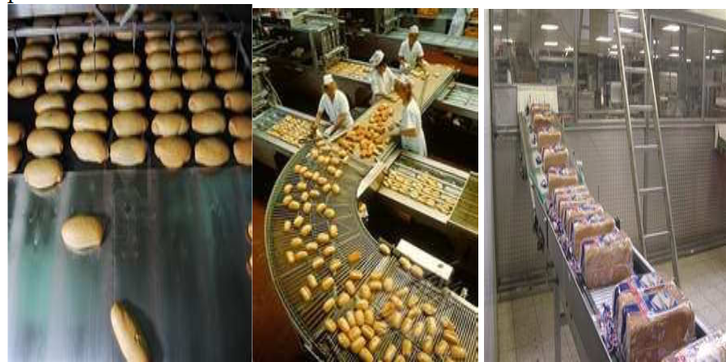
Firm

Slide 18
Functions of Entrepreneur
Initiating a business enterprise and resource co-ordination.
Risk Bearing or Uncertainty Bearing –
i) Financial risk and ii) Technological risk
Innovations - It may mean the introduction of a new method of production or an improvement in the old method.

Slide 19

examples
Bill Gates (Microsoft), Michael Dell (Dell computer) etc. are the examples of outstanding entrepreneur's.

Slide 20
Is land capital ?
Land is not regarded as capital because
i) Land is a free gift of nature but capital is man-made;
ii) Capital is perishable, whereas land is permanent;
iii) The amount of capital can be increased but the quantity of land is fixed and limited; and
iv) Income from capital is uniform whereas rent of land varies.

Slide 21
SELF-ASSESSMENT EXERCISE
List all factors of production with very brief explanation on each one.

Slide 22
Production function
Production involves transformation of inputs such as capital, equipment, labor, and land into output - goods and services.
In this production process, the manager is concerned with efficiency in the use of the inputs.
Technological and economic efficiency

Slide 23
Input -output
Input : they are resources used in production process; these are factors of production i.e. land; labour, capital and entrepreneur.
Output
Transformation of factor of production into goods and services that are used in satisfying consumer’s want is referred to as output.

Slide 24
Production Function
The production function neither provide any information on the least cost capital, nor does it reveal the output rate that will yield the maximum profit.
The production function simply reveal the maximum output that can be obtained from any and all input combination under a given state of technology.
Q = f( L, K, R, L_{d}, T, t) Where
Q = output R= Raw Material
L= Labour L_{d} = Land
K= Capital T = Technology
t = time

Slide 25
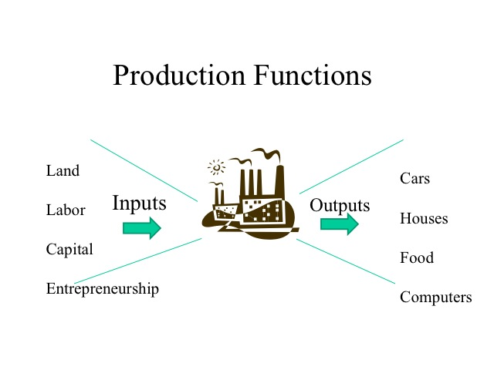
Production Function

Slide 26
Production Function
For our current analysis, let’s reduce the inputs to two, capital (K) and labor (L)
Q = f(L, K)

Slide 27
Relationship among different Product
The term “product” describes the volume of goods produced by a business or industry over a certain period.
The product concept can be seen from three different perspectives:
Total Product
Average Product
Marginal Product

Slide 28
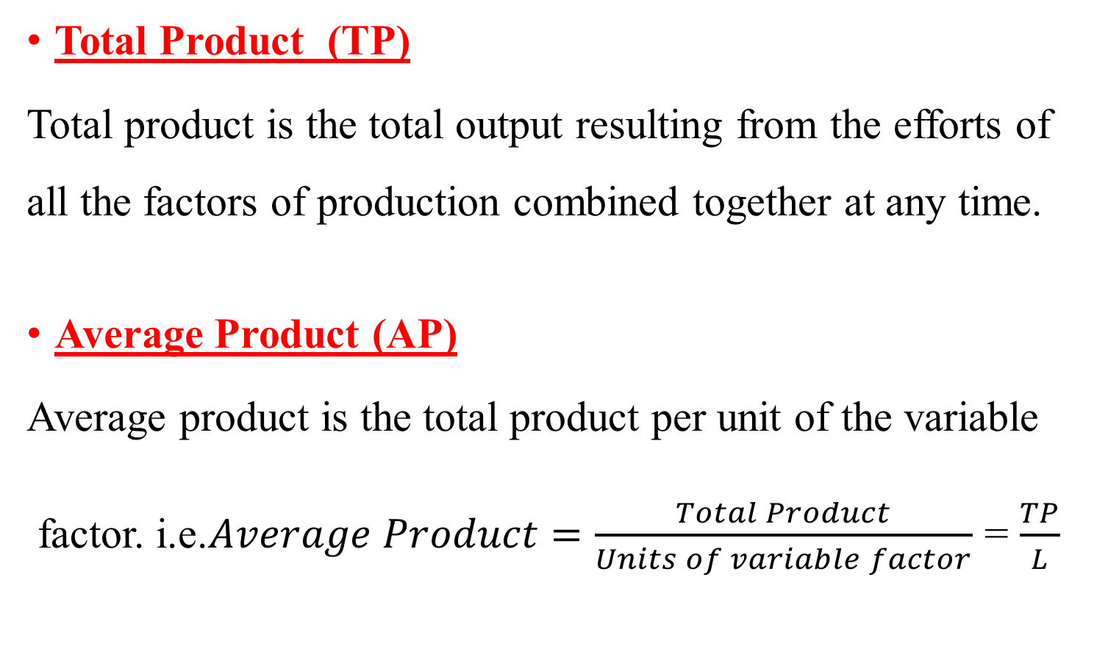
Total Product
Total Product (TP)
Total product is the total output resulting from the efforts of all the factors of production combined together at any time.
Average Product (AP)
Average product is the total product per unit of the variable
factor. i.e.$Average Product=\frac{Total Product}{Units of variable factor}$ = $\frac{TP}{L}$

Slide 29
Average Product & Marginal Product
Marginal Product (MP) Marginal product is the change in total product per unit change in the quantity of variable factors. In other ways, marginal product leads to an increase of total product with the help of additional worker or input.
For instance if initial total product of wallet was 10, however the firm raised the total product by 3 by incurring more cost on one of the variable input. Then the MP is 3

Slide 30

$Marginal Product={TP}_{n} − {TP}_{n−1}= \frac{∆TP}{∆L}$
TP is the sum of MP, i.e., TP=∑MP

Slide 31
marginal product
What is an example of a marginal product?
A good example of the marginal product of labor is a kitchen in a restaurant. With no cooks, the restaurant's production will be 0. When one cook is hired, the restaurant's production may increase to 10 meals, yielding a positive MPL of 10.

Slide 32
marginal product
How is Total Product derived from Marginal Product?
For any degree of input, the sum of marginal products of every foregoing unit of that input gives the total product. So, the total product is the sum of marginal products.
TP is the sum of MP, i.e., TP=∑MP

Slide 33
Short-run & Long-run
Short-run
This is a period of time in production process when changes in variable factors of production determines the firm’s output while one or more of the firm’s input is fixed.
Long-run
This is a period of time in production process when all factors of production are varied that is no fixed factor. Increase in all factor of production is required to increase the firm’s output.

Slide 34
Relationship among different Product
Product Schedule
Quantity of Labour | Total Product (TP) | Average Product (AP) | Marginal Product (MP)
1 | 100 | 100.00 | ----
2 | 210 | 105.00 | 110
3 | 330 | 110.00 | 120
4 | 430 | 107.50 | 100
5 | 520 | 104.00 | 90
6 | 600 | 100.00 | 80
7 | 670 | 95.70 | 70
8 | 720 | 90.00 | 50
9 | 750 | 83.30 | 30
10 | 750 | 75.00 | 00
11 | 740 | 67.20 | -10

Slide 35
Relationship among different Product
Relationship between TP and MP:
When MP is increasing, TP is increasing at an increasing rate
When MP is falling, TP is increasing at a decreasing rate
When MP is at zero, TP is at the maximum
When MP is negative, TP is falling

Slide 36
Relationship among different Product
Relationship between AP and MP:
When MP is increasing, AP is increasing
MP cuts AP at the latter’s maximum point
When MP is above AP, AP is rising.
When MP is below AP, AP is falling.

Slide 37
Law of Variable Proportion
It refers to input-output relationship, when the output in increased by varying the quantity of one input.
Law operates in short-run when all the factors production cannot be increased or decreased.
Law states that “As we increase the quantity of one input which is combined with other fixed inputs, the marginal physical productivity of the variable input must eventually decline.”

Slide 38
Law of Variable Proportion
Assumptions
One of the factors is variable while all other factors are fixed.
All units of the variable factor are homogenous.
State of technology is constant.
Factors of production can be used in different proportions.
The products are measured in physical units. Example, quintals, tons etc.
It is assumed that all variable factors are equally efficient.
Only applicable under short run.

Slide 39
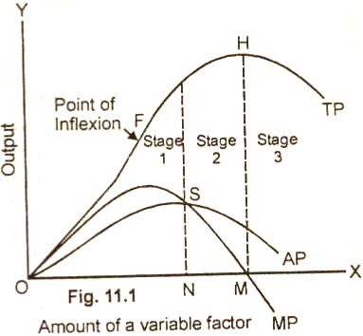
Law of Variable Proportion
E

Slide 40
Law of Variable Proportion
Stages | Total Product | Average Product | Marginal Product
1st Stage (O to E) (MP > AP) Law of Increasing Returns | Initially it increases at an increasing rate. Later at diminishing rate. | Initially increases and reaches the maximum point. Then start declining. | Increases and reaches its maximum point. Then start declining. Here AP = MP
2nd Stage (E to H) (MP < AP) Law of Diminishing Returns | increases at diminishing rate and reaches at maximum point. | Decreases. | After reaching its maximum point begins to decrease and become zero at point M.
3rd Stage (Beyond H) (MP > AP) Law of Negative Returns | Begins to fall. | Becomes positive. | Continues to diminish but remains negative.

Slide 41
Economic Implications of the Law of Variable Proportion
In the first stage, as more and more labour is used, the average product of labour increases which reflects the increasing efficiency of labour. In this stage, the total product increases which shows that the efficiency of land is increasing too . Hence, this stage shows that both land and labour are being efficiently utilized.
In the second stage, the average and marginal product is decreasing. But since the total output goes on increasing, the marginal product is positive.

Slide 42
This stage shows the decreasing efficiency of labour. But the efficiency of land continues to increase because the total return continues to increase.
In the third stage, the average product decreases still further. Also, the marginal product becomes negative and the total product is decreasing. Hence, in this stage, both labour and land have been used inefficiently.

Slide 43
Stage of Operation and Causes of Applicability of the Law
Stage of Operation
A Rational Producer will not Produce in
Stage 3 as MP of variable factor is negative.
Stage 1 as factors of production is under utilized
A rational producer will always produce in Stage 2 where both the Marginal and Average product of the variable factors are diminishing . At which the particular point in this stage, a producer will decide to produce depends upon the prices of factors.

Slide 44
Law of Variable Proportion – Limitations and Conclusion
Limitations of Law
i) Improved methods of cultivation;
ii) New soil;
iii) Insufficient capital.

Slide 45
Conclusion
The combination of land and labour attained maximum efficiency of labour at the boundary line between stage one and stage two and maximum efficiency of land at the boundary line between stage two and stage three. Stages one and three are ruled out. Stage one is ruled out because throughout this stage average product of both land and labour are still increasing and stage three is ruled out because the average product of both factors is decreasing. Finally, stage two represents higher efficiency of land-labour ratio than that of the other two stages.

Slide 46
SELF-ASSESSMENT EXERCISE
Who is an entrepreneur?
Relationship among different Product.
Define the following:
a. Fixed factors and Variable factors
b. Input and output
c. Entrepreneur and labour
d. Land and capital

Slide 47
SELF-ASSESSMENT EXERCISE
2. What is production function?
3. Explain what you understand by short-run and long-run in the production process

Slide 48
Book reference
Samuelson,PaulA; Nordhaus, William D. (2014). Economics. Boston, Mass: Irwin McGraw-Hill.

Slide 49
Economies of the Scale of Production-External Economies of Scale
External economies of scale are those economies which are not specially availed of by .any firm. Rather these accrue to all the firms in an industry as the industry expands.
The main external economies are as under:
(I) Economies of localization. When an industry is concentrated in a particular area, all the firms situated in that locality avail of some common economies such as (a) skilled labor, (b) transportation facilities, (c) post and telegraph facilities, (d) banking and insurance facilities etc.

Slide 50
Economies of the Scale of Production-External Economies of Scale
(ii) Economies of vertical disintegration. The vertical disintegration implies the splitting up the production process in such a manner that some Job are assigned to specialized firms. For example, when an industry expands, the repair work of the various parts of the machinery is taken up by the various firms specialists in repairs.
(iii) Economies of information. As the industry expands it can set up research institutes. The research institutes provide market information, technical information etc for the benefit of alt the firms in the industry.
(iv) Economies of by products. All the firms can lower the costs of production by making use of waste materials.

Slide 51
Diseconomies of Scale
Definition: The extensive use of machinery, division of labor, increased specialization and larger plant size etc., no doubt entail lower cost per unit of output but the fall in cost per unit is up to a certain limit. As the firm goes beyond the optimum size, the efficiency of the firm begins to decline. The average cost of production begins to rise.
Factors of Diseconomies
(i) Lack of co-ordination. As a firm becomes large scale producer, it faces difficulty in coordinating the various departments of production. The lack of co-ordination in the production, planning, marketing personnel, account, etc., lowers efficiency of the factors of production. The average cost of production begins to rise.
(ii) Loose control. As the size of plant increases, the management loses control over the productive activities. The misuse of delegation of authority, the red-tapism bring diseconomies and lead to higher average cost of production.

Slide 52
Diseconomies of Scale
(iii) Lack of proper communication. The lack of proper communication between top management and the supervisory staff and little feed back from subordinate staff causes diseconomies of scale and results in the average cost to go up.
(iv) Lack of identification. In a large organizational structure, there is no close liaison between the top management and the thousands of workers employed in the firm. The lack of identification of interest with the firm results in the per unit cost to go up.

Slide 53
External Diseconomies:
Definition: A firm or an industry cannot avail of economies for an indefinite period of time. With the expansion and growth of an industry, certain disadvantage also begin to arise. The diseconomies of large scale production are:
(I) Diseconomies of pollution, (ii) Excessive pressure on transport facilities, (iii) Rise in the prices of the factors of production, (iv) Scarcity of funds, (v) Marketing problems of the products, (iv) Increase in risks.

